Slide 1
Machine Learning and Deep Learning Models for COVID-19 Diagnosis
A Comprehensive Approach Using Chest X-rays
Presented by: Hayato Yuuto Kakinuma 13/12/2024

Slide 2

Project Overview
In response to the global COVID-19 pandemic, this project aims to enhance diagnostic methods using machine learning and deep learning tools to analyze chest X-ray images for faster and effective COVID-19 detection.

Slide 3
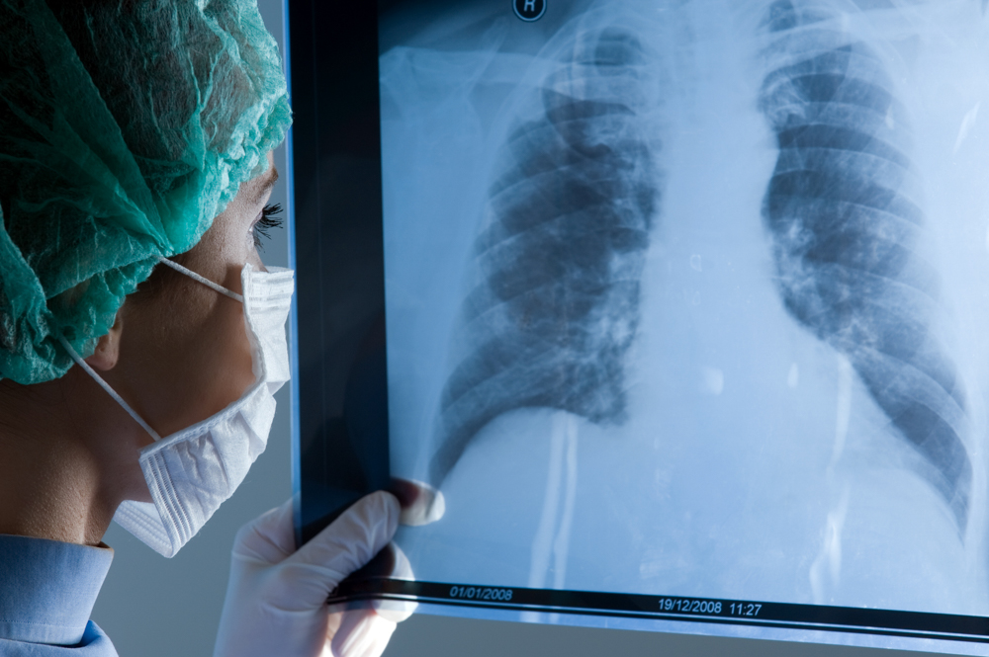
Importance of Diagnostic Improvements
While RT-PCR is the gold standard for COVID-19 testing, it has limitations in speed and resource demand. Chest X-rays, being more accessible and quicker, can significantly supplement existing diagnostic methods.

Slide 4
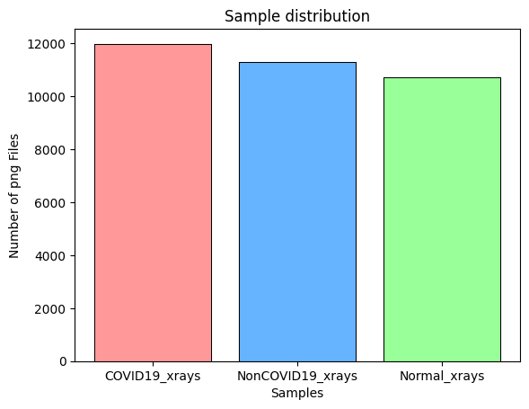
Data collection
Utilizing the COVID-QU-Ex dataset from Kaggle, consisting of 33,920 chest X-ray images categorized into COVID-19 positive, Non-COVID infections, and Normal.

Slide 5
Preprocessing Techniques to increase the robustness of our models.
Raw data
preprocessing steps
data augmentation
normalisation
resizing
rotation, flipping
Elastic transform, Gaussian blur
mean and std of 0.5
256x256 pixels
(gentle application)

Slide 6
Introduction to Machine Learning Tools
01
02
03
04
Started with VSCode for initial model development
switch to Google Colab for cloud-based GPU access
- but faced limitations due to local hardware constraints
Tested HOG and GLCM feature extractions
Traditional classifiers: SVM, RF, KNN, XGBoost
Notes:
3 - Techniques like histogram of oriented gradients (HOG) and grey-level co-occurrence matrices (GLCM) were used to extract key features from the images

Slide 7
Deep Learning with TensorFlow
CNN ResNet50 transfer learning
Fine-tuned with AdamW
Initially chose TensorFlow for its extensive library and pre-trained models but encountered issues with T4 and L4 GPU compatibility in Colab, impacting model training and performance.
Froze the base layer and later gradually unfreeze the last 10, 20, 50 layers. The model struggled to exceed test accuracy of 70% and validation accuracy of 50%

Slide 8
Transition to PyTorch
CNN ResNet50 non-transfer learning
Fine-tuned with Adam
Switched to PyTorch due to its dynamic computation graph and efficient GPU usage (more compatible with Colab), which enhanced model training and allowed more complex model experimentation
Froze the base layer to fully utilise ResNet50 that was trainined in ImageNet. 50 epochs were set but early stop kicked in at 11th epoch, saving 10th epoch as the best model at training accuracy of 86.52% and validation accuracy of 80.64%.

Slide 9
CNN Architecture in Depth
The CNN model is built using PyTorch with the ResNet-50 architecture, optimized for image recognition tasks. Key features include convolutional layers, ReLU activations, and pooling layers designed to capture detailed features in X-ray images.
Stage | Depth | Height | Width | Filter Height | Filter Width
Initial Convolution | 64 | 128 | 128 | 7 | 7
Max-Pooling | 64 | 64 | 64 | 3 | 3
Residual Block 1 | 256 | 64 | 64 | 3 | 3
Residual Block 2 | 512 | 32 | 32 | 3 | 3
Residual Block 3 | 1024 | 16 | 16 | 3 | 3
Residual Block 4 | 2048 | 8 | 8 | 3 | 3
Global Average Pooling | 2048 | 1 | 1 | 8 | 8
Fully Connected Layer (2048 → 512) | 512 | 1 | 1 | - | -
Fully Connected Layer (512 → 3) | 3 | 1 | 1 | - | -
Notes:
This schematic reflects modifications, especially the dropout and batch normalization, which help mitigate overfitting and improve training stability.

Slide 10
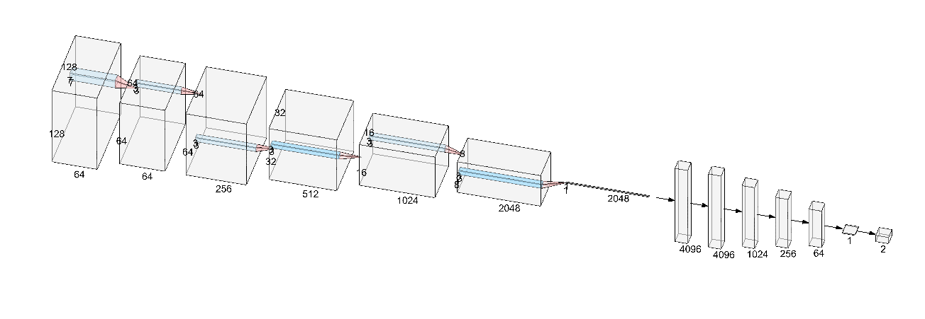
CNN Architecture in Depth
The CNN model is built using PyTorch with the ResNet-50 architecture, optimized for image recognition tasks. Key features include convolutional layers, ReLU activations, and pooling layers designed to capture detailed features in X-ray images.
Stage | Depth | Height | Width | Filter Height | Filter Width
Initial Convolution | 64 | 128 | 128 | 7 | 7
Max-Pooling | 64 | 64 | 64 | 3 | 3
Residual Block 1 | 256 | 64 | 64 | 3 | 3
Residual Block 2 | 512 | 32 | 32 | 3 | 3
Residual Block 3 | 1024 | 16 | 16 | 3 | 3
Residual Block 4 | 2048 | 8 | 8 | 3 | 3
Global Average Pooling | 2048 | 1 | 1 | 8 | 8
Fully Connected Layer (2048 → 512) | 512 | 1 | 1 | - | -
Fully Connected Layer (512 → 3) | 3 | 1 | 1 | - | -
Max-Pooling
Residual Block
Fully Connected Layer
Initial convolution
Global Average Pooling
Notes:
This schematic reflects modifications, especially the dropout and batch normalization, which help mitigate overfitting and improve training stability.

Slide 11
Model Training Details
Model training involved multiple epochs with batch size adjustments, learning rate optimization, and the use of an NVIDIA L4 GPU to speed up computations and handle the large dataset efficiently.
Specification | Details | Compatible Python Libraries
GPU Architecture | Ada Lovelace | PyTorch, TensorFlow, Numba
CUDA Cores | 7680 | PyCUDA, CuPy, RapidsAI
Tensor Cores | 240 | TensorFlow, PyTorch, XGBoost
Memory Size | 24 GB GDDR6 | PyTorch, TensorFlow, CuPy
Memory Bandwidth | 300 GB/s | PyCUDA, CuPy, RapidsAI
Peak FP32 Performance | 30.3 TFLOPS | PyTorch, TensorFlow, Numba
Power Consumption | 72W | –
Form Factor | PCIe (Low Profile) | –

Slide 12

Challenges in Model Training
Faced challenges such as data transfer delays and steep learning curves with new tools. Even mounting Google Drive to Colab did not help so much. Colab memory is non-persisting after runtime reset. * Implemented solutions like dataset zipping and unzipping directly in Colab to mitigate I/O bottlenecks.
>> implementation of !gdown and !unzip

Slide 13
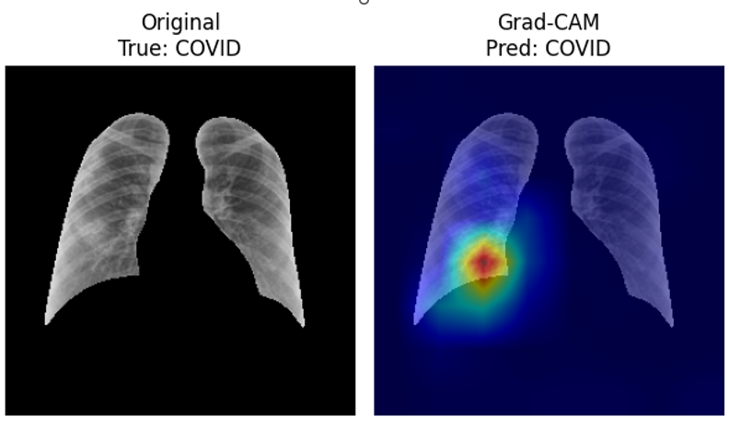
Model Evaluation Criteria
01
04
02
03
Grad-Cam
Accuracy, precision, recall, F1 score
Training/Validation loss and accuracy convergence plot
Confusion Matrix

Slide 14
Results: Machine Learning Models
Compared traditional machine learning models like XGBoost, which showed competitive results but lacked the nuanced pattern recognition capabilities of CNNs.
Class | Precision | Recall | F1-Score | Support
COVID | 0.81 | 0.85 | 0.83 | 150
Non-COVID | 0.94 | 0.73 | 0.82 | 150
Normal | 0.71 | 0.82 | 0.76 | 150

Slide 15
Results: Deep Learning Models
The CNN model demonstrated superior ability to recognize and classify COVID-19 from X-ray images with a high degree of accuracy, reflecting the effectiveness of deep learning in medical imaging
Class | Precision | Recall | F1-Score | Support
COVID | 0.91 | 0.76 | 0.83 | 1770
Non-COVID | 0.80 | 0.79 | 0.80 | 1680
Normal | 0.77 | 0.90 | 0.83 | 1638

Slide 16
Lessons Learned from Tool and Framework Switches
The transition from TensorFlow to PyTorch highlighted the importance of choosing the right tools for specific computational needs and the advantages of flexible, dynamic frameworks in deep learning projects. Pytorch was more intuitive to use nd easily compatible with Colab native libraries. Debugging with Tensorflow was more challenging.

Slide 17
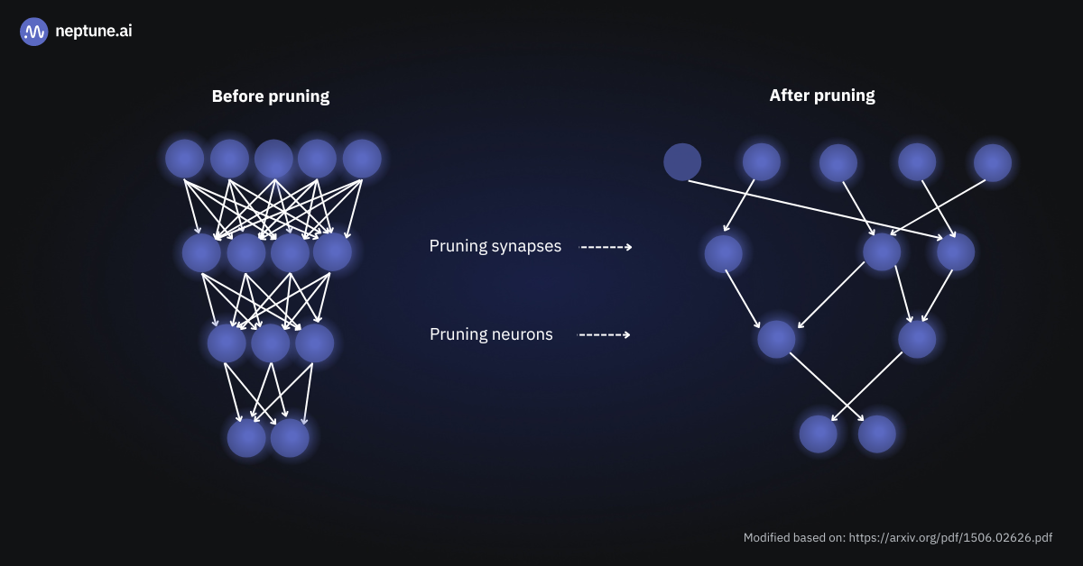

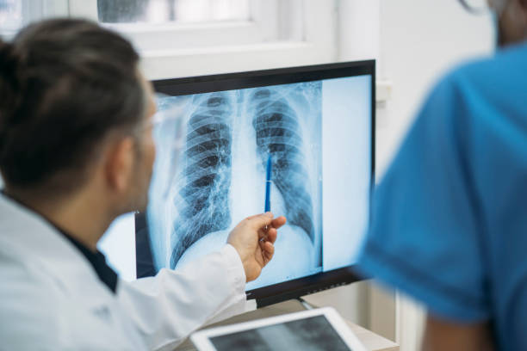
Future Directions
Model optimisation
Integration of newer deep learning models
Expand dataset

Slide 18

Conclusion
Our CNN model, optimised with PyTorch, classifies chest X-ray images into COVID-19, non-COVID, and normal categories.
This project aids in rapid COVID-19 screening, especially valuable in resource-limited settings, and reduces reliance on conventional testing methods (PCR/Strip test).
Notes:
This project illustrates the potential of machine learning and deep learning in an attempt to revolutionise medical diagnostics, with significant implications for rapid, scalable, and effective COVID-19 testing.

Slide 19
Q&A
Thank you for your attention! I welcome any questions or feedback.

